Slide 1

Loan Approval Prediction Using Machine Learning
Miss Shraddha Sonawane
Msc Statistics
Prn No: 1332250077

Slide 2
Introduction
The dataset for this project is obtained from Kaggle.
The dataset contains variables as applicant details, income, loan amount, credit history, and loan status and size (45000,14).
The main objective is to predict whether a loan application will be approved or rejected.
Data pre-processing and feature selection are performed to prepare the data for modelling.
Logistic Regression, Decision Tree, and SVM algorithms are used for prediction.
Class weighting and SMOTE are applied to address class imbalance.
Model performance is evaluated using accuracy, precision, recall, and F1-score.
The final aim is to identify a suitable machine learning model for loan approval prediction.

Slide 3
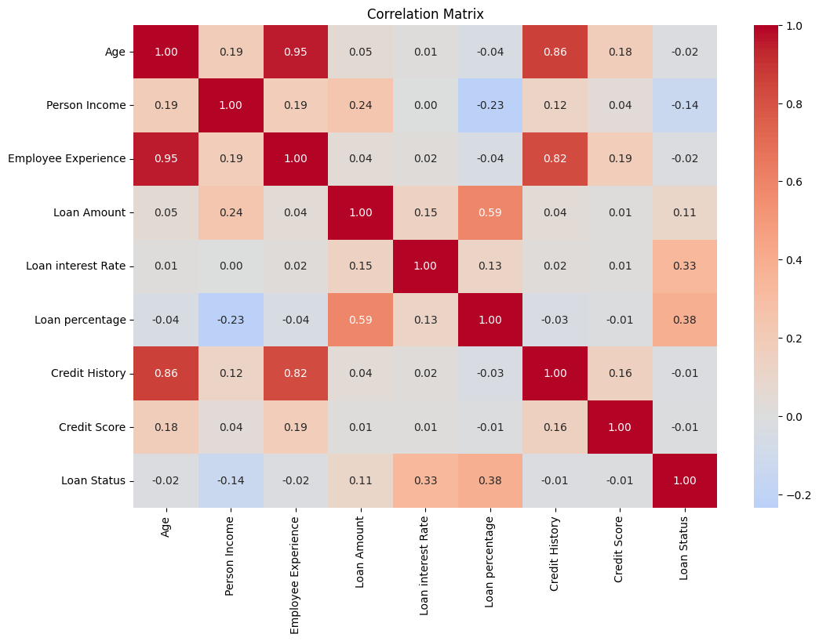
Correlation Matrix
The heatmap shows a strong correlation between Age and Employee Experience (0.95). Loan Status is moderately correlated with Loan Percentage (0.38) and Loan Interest Rate (0.33). These relationships help identify potential multicollinearity and understand feature associations.

Slide 4
.
Feature Engineering
Removed Gender, Education, and Previous Loan columns.
Selected the remaining variables for model building.
Encoding
Converted categorical variables into numerical values using Label Encoding.
Prepared the data for machine learning algorithms.
Train-Test Split
Split the dataset into 80% training and 20% testing data.
Training data was used to build models, while testing data evaluated their performance.

Slide 5
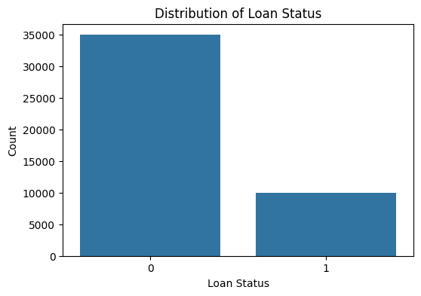

Slide 6
SMOTE Analysis
Before SMOTE: Training dataset contained 36,000 observations and 10 features.
After SMOTE: Training dataset increased to 56,000 observations by generating synthetic minority-class samples.
Test Dataset: Remained unchanged at 9,000 observations to ensure fair model evaluation.
Objective: Balance the target classes and improve minority-class prediction.
Evaluation: Compare model performance before and after SMOTE using precision, recall, F1-score, and accuracy.
Model | Training Accuracy | Testing Accuracy | Overfitting Gap
Logistic Regression | 77.55% | 77.38% | 0.18%
Decision Tree | 81.84% | 86.22% | −4.38%
SVM | 83.24% | 82.38% | 0.87%

Slide 7
Class Weighting
Class weighting assigns higher importance to the minority class during model training.
It helps reduce bias toward the majority class in an imbalanced dataset.
Weighted Logistic Regression, Decision Tree, and SVM were developed and compared.
Model performance was evaluated using training accuracy, testing accuracy, and overfitting gap.
Model | Training Accuracy | Testing Accuracy | Overfitting Gap
Weighted Logistic Regression | 76.68% | 77.16% | −0.48%
Weighted Decision Tree | 87.85% | 87.34% | 0.50%
Weighted SVM | 83.53% | 83.38% | 0.16%

Slide 8
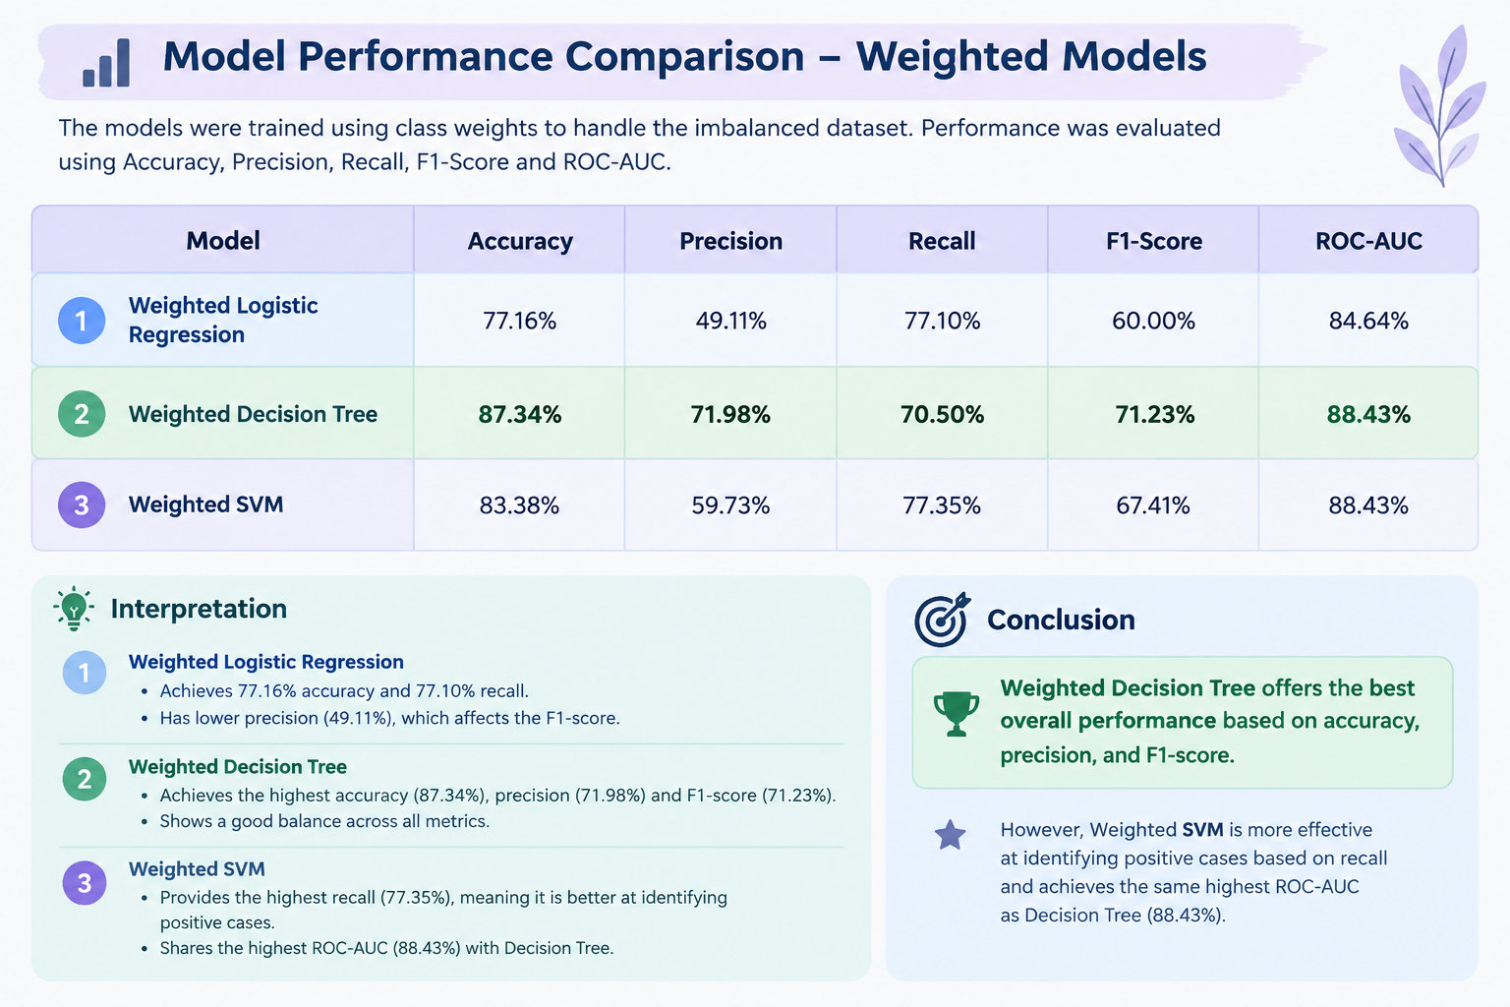

Slide 9
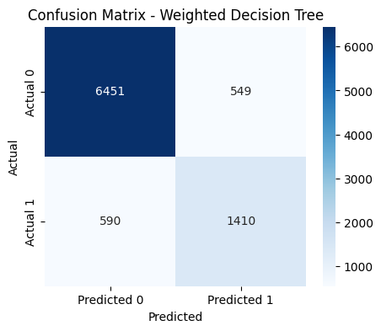
Confusion Matrix – Weighted Decision Tree
True Negative (6451): Correctly predicted applications as Class 0.
False Positive (549): Incorrectly predicted Class 0 applications as Class 1.
False Negative (590): Incorrectly predicted Class 1 applications as Class 0.
True Positive (1410): Correctly predicted applications as Class 1.
Interpretation: The model correctly classified 7,861 out of 9,000 applications, achieving 87.34% accuracy. It performs well in identifying Class 0, but some Class 1 cases are misclassified.

Slide 10
Conclusion
Machine learning models can support loan approval prediction.
Class imbalance techniques help address unequal class representation.
Weighted Decision Tree performed best based on accuracy, precision, and F1-score.
Final selection should also consider the business cost of incorrect predictions.

Slide 11
THANK YOU!!

